Slide 2
Compliance Essentials
The Only Thing Constant Is Change.

Slide 3
Compliance with federal and state housing regulations. Ongoing monitoring to ensure program integrity. Navigating complex rules to maintain affordable housing standards. Strict documentation and reporting requirements. Transparency in financial practices and tenant eligibility. Assessing each project for long-term viability and fairness. Nurturing trust between developers, tenants, and regulatory bodies. Timely adherence to all regulatory deadlines and requirements.
This acrostic emphasizes the continuous and consistent effort needed to ensure compliance with LIHTC standards and regulations.

Slide 4
Change:
To make something different; alter or modify.

Slide 5
Certification Portal (COL) The portal will be utilized more efficiently moving forward. The 2025 AOC will be posted as a template in COL for accessibility and completion. Your reports will be submitted to MHC via file upload in COL. Correspondence from MHC to owners & management will be uploaded for your view

Slide 7
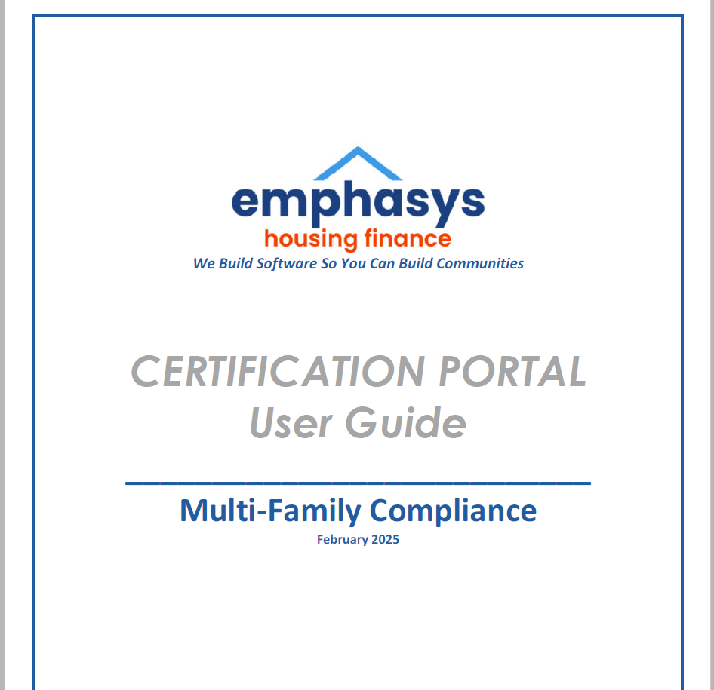
This manual has been designed to provide basic familiarity with the functionality of
Certification Portal, showing capabilities and to aid the user in all facets of the system’s
procedures and screen entry.
✓ Dashboard:
A comprehensive dashboard provides an overview of projects and processes.
✓ Document Repository: A secure location where users can access, view, and download
important documents that have been uploaded into the system.
Notes:
AOC Report and submissions, and E-docs will be available in COL. We have user guide available for your use. It will be posted to the website under resources.

Slide 8
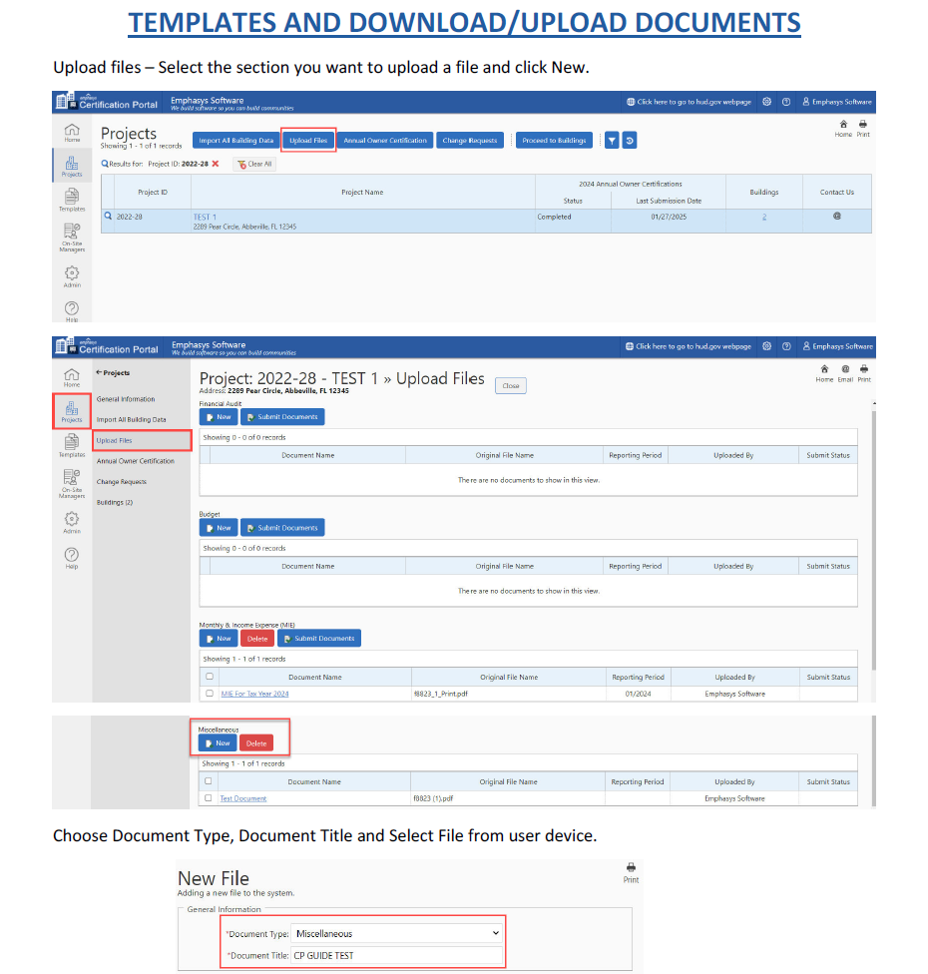
Notes:
AOC Report will now be due 05/31/25 and will be submitted

Slide 9
 | MISSISSIPPI HOME CORPORATION
 | UTILITY ALLOWANCE REQUEST SUBMITTAL CHECKLIST
 | Date of Request: _________________________ | Proposed Effective Date: ___________________
 | Project Name:______________________________ | Project Number: ___________________________
 | Ownership Name:___________________________ | Contact Person: ____________________________
 | IMPORTANT NOTE: MHC's UA review will NOT commence until reciept of a complete request submission, inclusive of all applicable attachments/reports. The UA Requests must be packaged SEPARATELY, by property and organized in accordance to this checklist. This checklist must accompany ALL UA Request submissions.
 | Document Type | Attached? (Make selection) | Date Submitted/Received
 | MHC Owner Certification of Utility Estimate (includes proposed UA average and executed by owner) | Applicable to ALL Requests
 | Utility Company Rate Schedule (copies required for each applicable utility type) | Applicable to ALL Requests
 | Copies of current Utility Bills (complete utility bills for every applicable utility; electric, water/sewer, gas, and trash for each bedroom size; for vacant or comparable units) | Applicable to ALL Requests
 | 90-Day Notice to Tenants (showing the date notice of proposed UA change was posted for viewing/comment as well as the proposed effective date; property name, address, mgmt. company and contact) | Applicable to ALL Requests
 | #5-HUD Utility Schedule Model Documentation (include the source and copies for all factors entered into the HUD Utility Schedule Model; and a printed copy of all inputs into the model) | HUD Utility Model Only
 | #6-Energy Consumption Model (ECM): Engineer's Energy Model Projection (A complete copy of the certification from the previously approved qualified professional explaining their analysis and findings. The analysis must explain how they addressed each required component as outlined in Section 1.42-10.) | ECM Only
 | (ECM)Engineer's & Owners' Identity of Interest (the licensed engineer and/or qualified professionals and ownership must not be related parties; statements needed from both) | ECM Only
 | (ECM) Engineer's Licensure/Resume (certification(s) of the licensed engineer or qualified professional, verification of experience; min. one year; license must be current and unexpired) | ECM Only
 | Processing Fee of $150 (payment should reference the development number and UA request) | Applicable to ALL Requests
 | Additional Documentation: (Current UA from local PHA; previously approved UA or any corrections requested to the above) | SELECT
 |  |  | MHC 11/2024
Notes:
In addition to file review and inspection correspondence, communication about UA Requests, CASU changes, and other determinations will be posted to the portal for accessibility and continuity.

Slide 10
CHANGES
Communication Policy
Authorized Signatory
Multiple Building Election
AOC accessible via COL
E-docs via COL
CMP Guide
Compliance.htc@mshc.com
PPOC = Management POC
At the time of Initial Status Report
Uploads of report parts via COL
Correspondence & uploads
Guidebook of compliance monitoring with focus on state-specific guidelines

Slide 11
Conformity with regulations ensures fairness and equity. Holding developers accountable for affordable housing standards. Assessing eligibility and financial integrity of tenants and projects. Navigating complex rules to maintain program integrity. Guaranteeing transparency and documentation throughout. Enhancing the sustainability of affordable housing initiatives.
This acrostic underscores key aspects of LIHTC Compliance, focusing on fairness, accountability, and transparency in the process.

Slide 12
Community growth fostered through investment. Helping families find safe, affordable homes. Access to quality housing for all income levels. Nurturing neighborhoods with sustainable development. Generating opportunities for long-term stability. Empowering residents with a foundation for success.
This acrostic highlights the impact of the Low-Income Housing Tax Credit (LIHTC) program on affordable housing and the broader community.

